Slide 1


Slide 2



Habtamu Bishaw Asres (PhD, Land policy and Governance)
Bahir Dar University, Ethiopia
Importance of Establishing Valuation Standard
in Ethiopia.
Notes:
Note: Please after inserting your picture, “Right Click” on the picture and “Send it to Back” to get the “Gradient” effect.

Slide 3

Agenda For Presentation
11:30 AM
01
Introduction
11:35 AM
02
Methodology
11:40 AM
03
Result and Discussion
11:55 PM
04
Concluding Remarks

Slide 4
Introduction (I)
Today the demand for valuation services has increased, which has led to a large increase in the number of specialists working in this field.
As a result, a professionalization process took place, resulting in the development of professional valuation specialists.
As time went on, these professionals felt the need to establish their own associations in order to better define and meet their needs, as well as to control their actions by issuing rules and regulations
One of the purposes of professional associations is to develop valuation standards.
03

Slide 5
Introduction (II)
In Ethiopia valuation is undertaken for various purposes
Empirical studies show that the valuation is done in a fragmented way
For instance, Asres, et al (2020 ) revealed that for mortgage purposes banks use it in a non-standard way
Another study by Asres (2019) found that valuation for expropriation does not follow any standard.
Asnakew and Amgne (2021) revealed that courts use different approaches during judgment execution.
03

Slide 6
Introduction (III)
Standards are a set of rules, professional, technical, and ethical guidelines, and; disclosure requirements that provide a common language to analyze, understand and compare the results and process universally.
Valuation standard is essential since valuation is complicated due to diverse tenure and land use arrangements which underlines the need for knowledgeable, skilled, and experienced valuers.
Having uniform valuation standards promote transparency and enhance confidence among investors, lenders, banks, and public and private entities.
03

Slide 7
Introduction (IV)
This can affect the outcome of the valuation
Several financial crises around the world are attributed to the consequences of poor valuation.
Therefore, the paper examines the importance of establishing a valuation standard compatible with the Ethiopian property market context
03

Slide 8
Methodology (I)
Research Approach…Qualitative research approach
Design …Exploratory design.
Data source- primary and secondary data sources.
Primary data was collected from experts working in valuation for different purposes (mortgage, property transfer, property tax, and expropriation)
while secondary data were secured from published and unpublished sources.
03

Slide 9
Methodology (II)
The key informants were selected using purposive and snowball sampling.
Accordingly 15 experts were interviewed. 4 from four commercial banks (CBE, Abay Bank, Awash Bank, Dashen Bank), 3 property transfer experts, 3 property tax experts, 3 experts working in expropriation, and 2 from Federal Land Administration institutions.
The data were analyzed using narration analysis and thematic classification.
03

Slide 10
Methodology (III)
Background of experts in interviewed
S.N | Purpose | # KIIs | Qualification
1 | Mortgage | 4 | All are Civil Engineers
2 | Expropriation | 3 | 1 LAS, Civil engineering, 1 NRM
3 | Property Transfer | 3 | 1 LAS, 2 Civil Engineering
4 | Property tax (land rent) | 3 | 2 Accounting, 1 Management
03

Slide 11
Result and Discussion (I)
The study found that a general legal framework is lacking
For expropriation Proc.1161/2019 and regulation No. 472/2020
Regional states enacted their own based on these laws
For mortgage, no specific law rather based on the interest of banks
They have the valuation manual but they are not voluntary to share.
03

Slide 12
Result and Discussion (II)
For property transfer tax directive no.3/2019
The value is based on the predetermined rate of land Value and BOQ of the improvement. The rate varies according to the zone
For land rent tax, there is no general framework at the federal level. However, it is collected in a fragmented way.
There is a rate developed by regional BoUI
For instance, in Bahir Dar city, the yearly residential land rent tax is 0.12* Area
For commercial it is a 3* Area
It works for old possessed properties while for leasehold there is no land rent tax.
03

Slide 13
Result and Discussion (III)
Courts use three basic ways to decide the cases related to the value of an expert witness.
Judgment execution directorate (in Addis)
Requesting the municipality or land administration office to estimate the value (most commonly used)
requesting the licensed real property valuers
03

Slide 14
Result and Discussion (IV)
Who regulates valuation? No single organ
S. No | purpose | Responsible Institutions |  | Responsible Institutions
 |  | Federal | Regional | Local
1 | Expropriation | MoUI & MoA | BoUI & BoL | Municipalities
2 | Mortgage | ----- | ---- | Banks
3 | Property tax (land rent tax) | Revenue Authority & MoUI | BoR | Municipalities
4 | Property Transfer | MoUI | BoUI | Municipalities
03

Slide 15
Result and Discussion (VI)
Valuation Education
Bahir Dar University commenced Bachelor’s and master’s courses in valuation
Recently other institutions start courses on valuation.
From the demand side still, there is resistance to not accepting new graduates (for instance, the valuation graduates are not part of the job structure in Bahir Dar city).
03

Slide 16
Result and Discussion (VI)
Valuation Approaches
Typically cost approaches have been used
Depreciation has not been deducted
The value of land is considered for property transfer and mortgage purposes but the value of the same land has different values
In expropriation, the value of land did not considered.
03

Slide 17
Result and Discussion (VII)
As a result valuation inaccuracy is common in Ethiopia (Asres, 2023, (Asnakew and Amogne, 2021).
Among many reasons, the absence of a valuation standard, inadequate valuation methodology used, the competence of valuers, and ethics of valuers.
Example; A commercial property sold for 22.8 million birr is valued at 5.3 million Birr in Bahir Dar, Fasilo sub-city. (330%)
The value of a property for different purposes has large gaps.
03

Slide 18
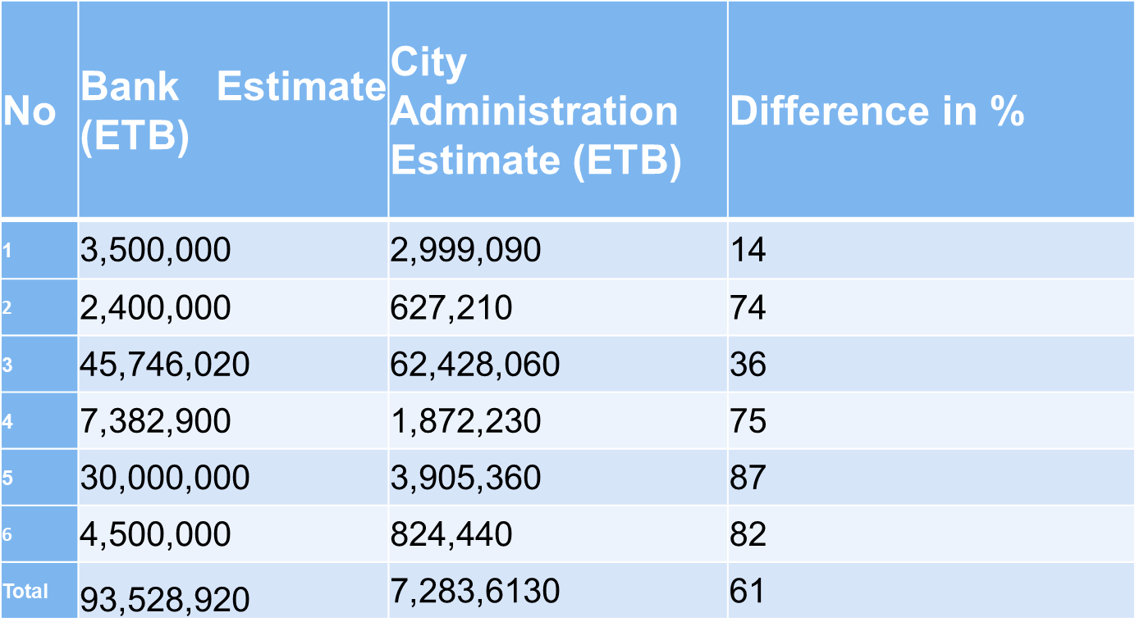
Result and Discussion (IX)
03

Slide 19
Result and Discussion (X)
Valuers Independence
For all purposes of valuation institutions employ their own internal valuers
The issue of independence is critical
Proc. 1160/2019 provides the possibility of using certified valuers or firms.
But, there are no certified valuers/firms in Ethiopia
Practically the valuation is done by employees of the bureau.
03

Slide 20
Result and Discussion (X)
Most valuers are Engineers
Since the cost approach is the typical method of valuation
Absence of other professional valuers
A strong belief that engineers are the ideal professionals to do valuations- low understanding of the valuation, they attached value with construction cost only
03

Slide 21
Conclusion (I)
Valuation in Ethiopia is done by non-professionals in a non-standard way
This is embellished by the absence of a comprehensive legal framework and the absence of the regulatory institution
Due to this valuation inaccuracy is very high
This affects rightsholders not get adequate credit, fair compensation, justice
when unethical practices for some purposes, it is treated by regular courts.
03

Slide 22
Conclusion (II)
courts resolve conflicts in valuation based on the opinion of value determined by other institutions.
The absence of independent valuation institutions with the lack of uniform standards in the country biased the implementation of the decision of the court and faced injustice.
03

Slide 23
Recommendation (I)
The study, therefore, urges the establishment of a specialized government agency with the primary task of formulating institutional and legislative frameworks and regulating the valuation in the country.
This can be a fertile ground for the emergence of a valuation professional association where the association will establish professional valuation standards compatible with the Ethiopian property market context.
The specialized government institution could take generally a facilitator role for valuation.
The developed institutional framework should aggressively build and protect the reputation of the profession from its very inception while holding the members of the profession accountable for their services
03

Slide 24
Thank you!!!
03

