Slide 1

Africa Valuation Conference
”Professionalism, Ethics and the future of the Built Environment
Dr Msizi Myeza
CBE: Chief Executive Officer
02 April 2025

Slide 2

  When talking to professionals in the built environment...
Learn to speak their language
Respect their time
Be practical
4.

Slide 3

  The democratically elected government key priority was to review the broader government legislation and policy framework
The Built Environment the regulatory system necessitate for a review due to:
Certain limitations in representativity in the sector
Need for government develop an inclusive built environment profession
Protecting the public interest through legislations
Drive professionalization of the sector
Government policy for Councils to be regulated within, inline with Government priorities and driving the national agenda
Hence, the establishment of the Council for the Built Environment (CBE) is a Schedule 3A Public Entity, a juristic body established in terms of section 2 of the Council for the Built Environment Act, 43 of 2000 (the CBE Act) to ensure for delivery of National mandate
Each CBEP is regulated by the its own Act, protects the titles of registered persons, i.e., prohibits unregistered persons from claiming to be registered by using the designated titles
Ensures quality, competency standards and development

Slide 4




















  Councils for the Built Environment Professions
MINISTER
PUBLIC WORKS AND INFRASTRUCTURE
The Council for the Built Environment (CBE) is a Schedule 3A Public Entity, a juristic body established in terms of section 2 of the Council for the Built Environment Act, 43 of 2000 (the CBE Act).
CBE
Council for the Built Environment Act 43 of 2000
COUNCIL FOR THE BUILT ENVIRONMENT
SACAP
SACLAP
ECSA
SACPVP
SACPCMP
SACQSP
Architectural Profession Act 44 of 2000
Landscape Architectural Professional
Act 45 of 2000
Engineering Profession Act of South Africa
Act 46 of 2000
Property Valuers Profession Act 47 of 2000
Project and Construction Management
Professions Act 48 of 2000
Quantity Surveying Profession Act 49 of 2000
SOUTH AFRICAN COUNCIL FOR
THE ARCHITECTURAL PROFESSION
SOUTH AFRICAN COUNCIL FOR
THE LANDSCAPE ARCHITECTURAL PROFESSION
SOUTH AFRICAN COUNCIL FOR THE PROPERTY VALUERS PROFESSION
SOUTH AFRICAN COUNCIL FOR THE PROJECT AND CONSTRUCTION MANAGEMENT PROFESSIONS
SOUTH AFRICAN COUNCIL FOR THE QUANTITY SURVEYING PROFESSIONS
ENGINEERING COUNCIL
OF SOUTH AFRICA
EAPASA
SAGC
SACPLAN
National Environmental Management
Act 107 of 1998
Geomatics Profession Act 19 of 2013
Planning Profession Act 36 of 2002
ENVIRONMENTAL ASSESSMENT PRACTITIONERS ASSOCIATION OF SOUTH AFRICA
SOUTH AFRICAN GEOMATICS COUNCIL
THE SOUTH AFRICAN COUNCIL FOR PLANNERS

Slide 5
  The Council for the Built Environment’s Vision
Vision Statement
An intelligent, inclusive, adaptive and thriving Built Environment by 2035
Intelligent
Inclusive
Adaptive
Thriving
  Improved use of data to make informed decisions.
  Encourage continuous learning among members and stakeholders.
  Regular engagement with a diverse range of stakeholders from various sectors of the built environment.
  Foster an organisational and operational culture that values diversity.
  Ensure that communication platforms and engagement methods are accessible to all.
  Implement mechanisms for reviews of strategies, projects, and programs to ensure they remain relevant and effective.
  Encourage a mindset of experimentation and learning.
  Efficiently allocate and manage resources,
  Foster a forward-looking approach. While addressing current challenges the CBE should also be laying the groundwork for future success.

Slide 6
  Mission & Values
Mission
Advancing a sustainable built environment by promoting public interest, professional growth, and best practices in health, safety, and governance
Achieving this Mission requires:
  a CBE that leads with vision,
  regulates with purpose,
  advises with expertise, and
  coordinates efforts to foster a sustainable and transformative built environment for all
Unwavering commitment to quality: Our standards remain high, ensuring excellence in every endeavour
Upholding professionalism: We embody expertise and integrity in every aspect of our work
Visionary thinking: We're forward-focused, anticipating the needs and possibilities of the future
Embracing inclusivity: We champion diversity and ensure that all voices are heard and respected
Values

Slide 7
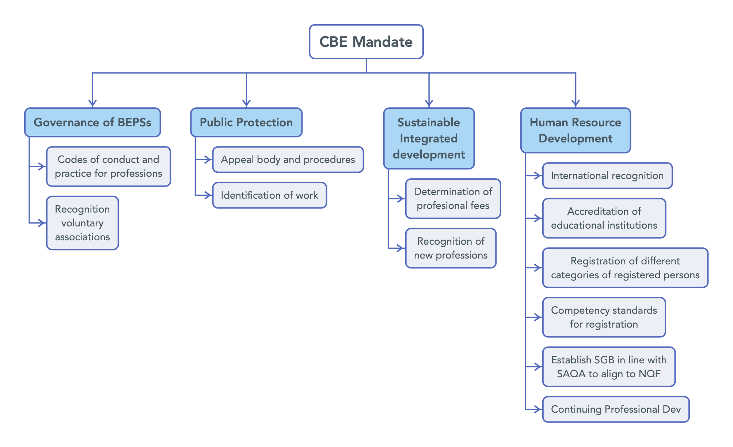
  CBE focus areas (norms and policies)

Slide 8
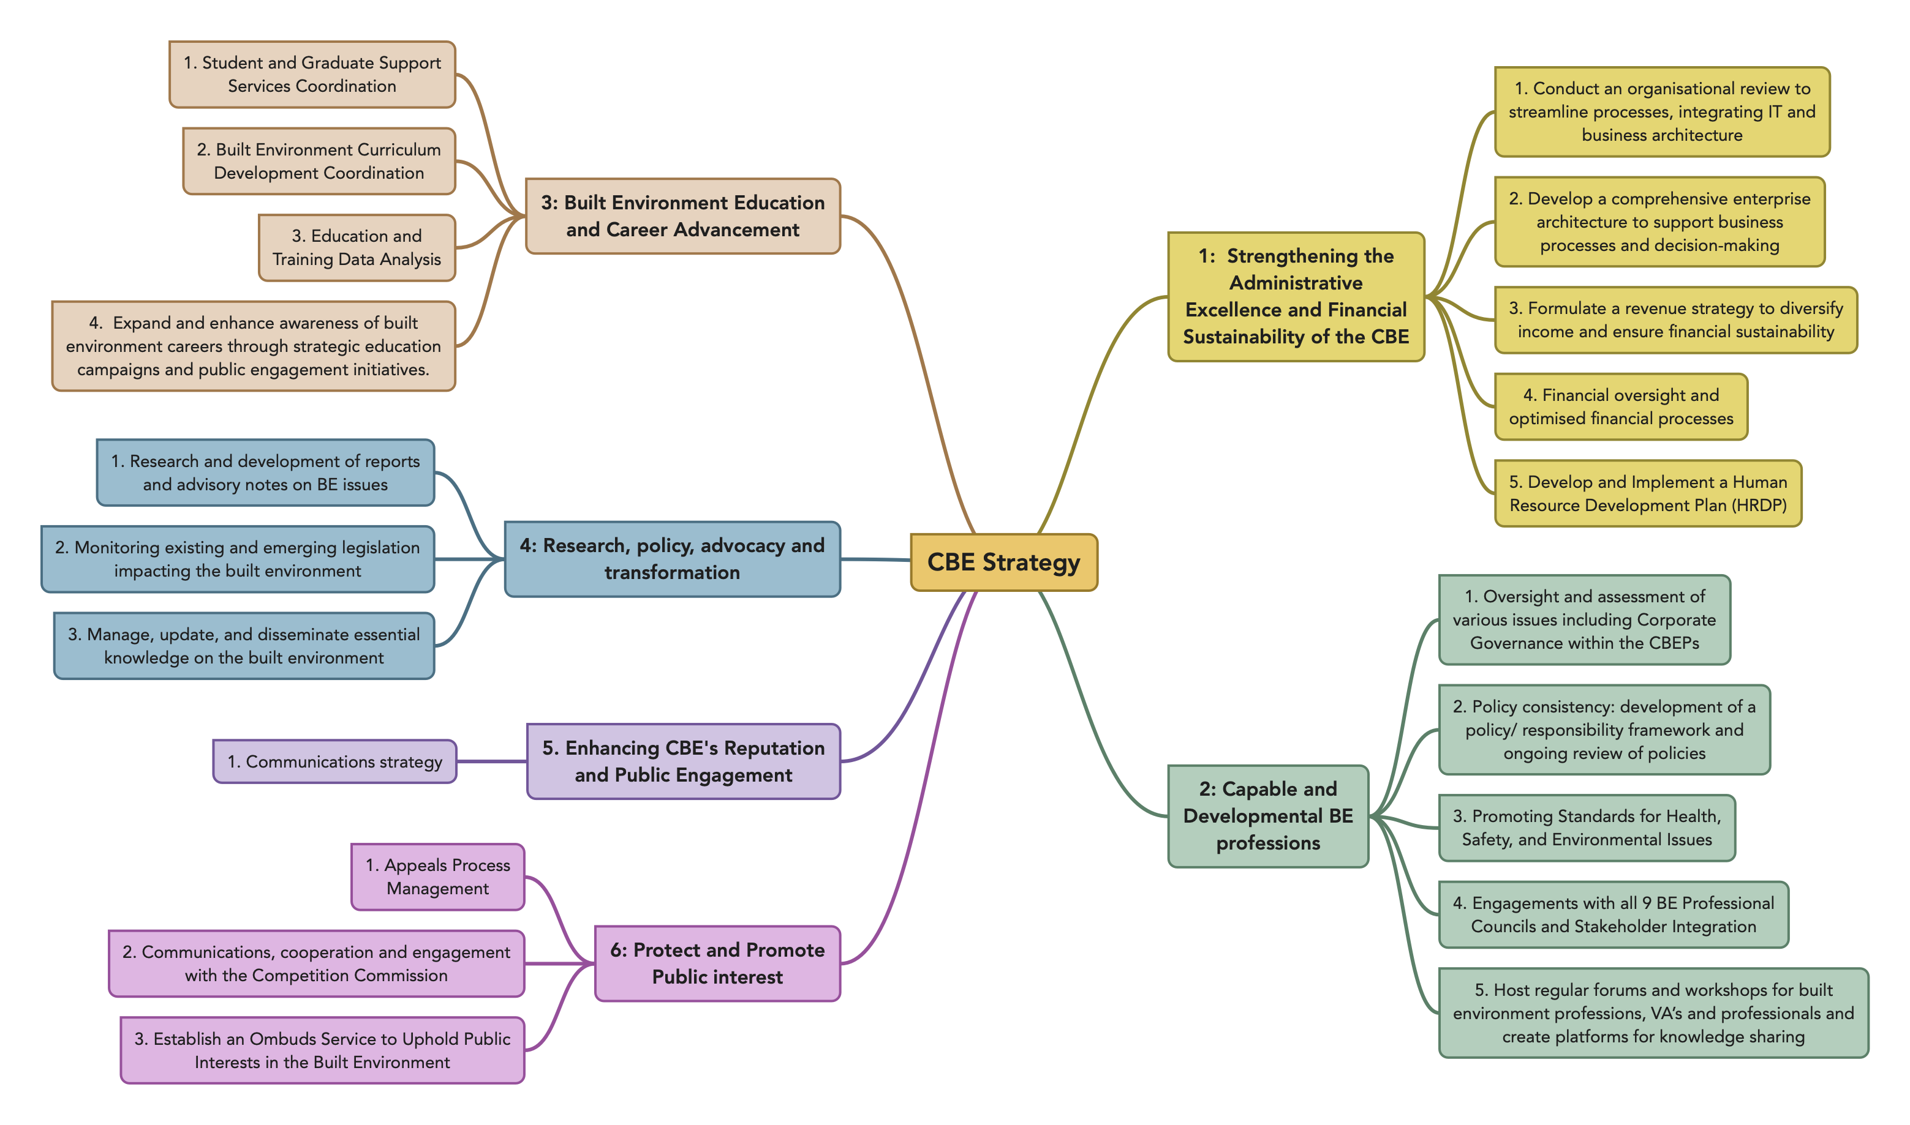
  Overview of CBE Strategy

Slide 9
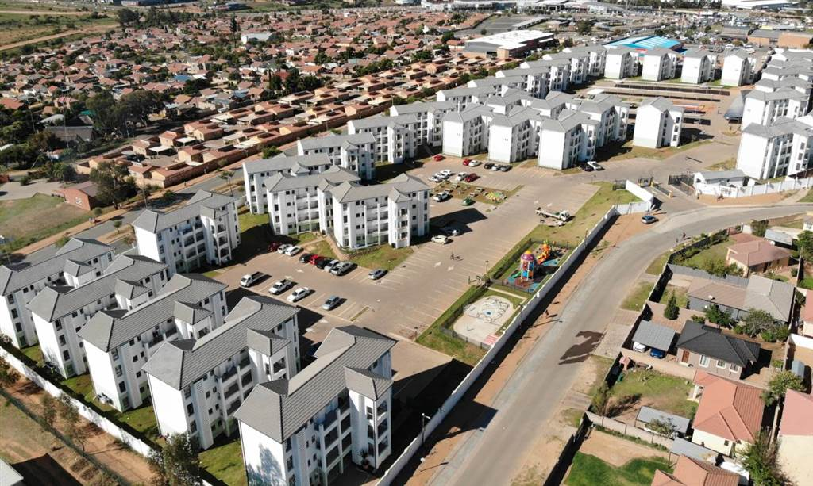
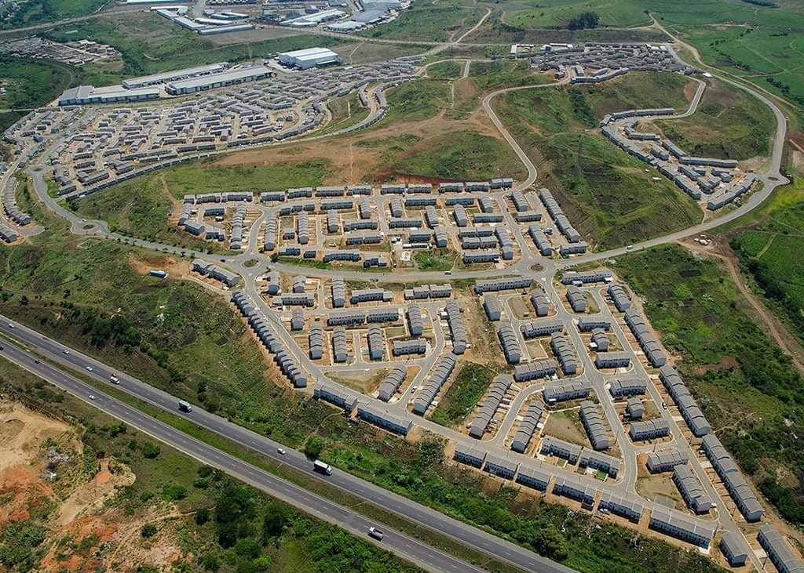
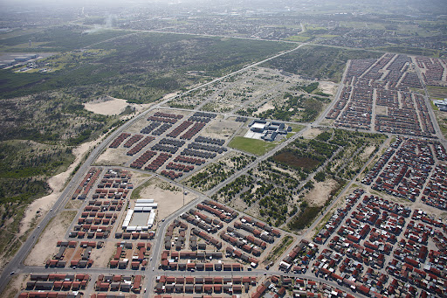
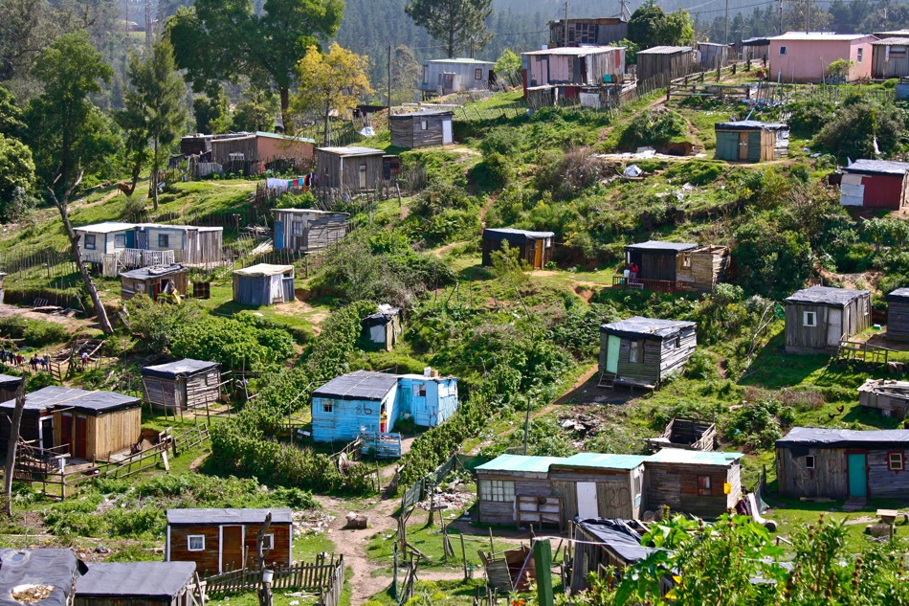
  Morphological changes
  In the past 30 years :
    We have witnessed a remarkable shift in attitudes, policies, and practices that have sought to create a more inclusive and sustainable built environment for all
    We have seen the emergence of new townships, innovative new cities, and ambitious mega human settlements projects
    The fusion of modern infrastructure, green spaces, and smart city technologies is reshaping the urban fabric of South Africa and paving the way for a more interconnected and sustainable future
    Challenges in service delivery in rural areas: the case of traditional areas
    Some of the standout developments that have garnered attention are the Cosmo City in Johannesburg, N2 Gateway Phase 1 in Cape Town, and Cornubia in eThekwini

Slide 10
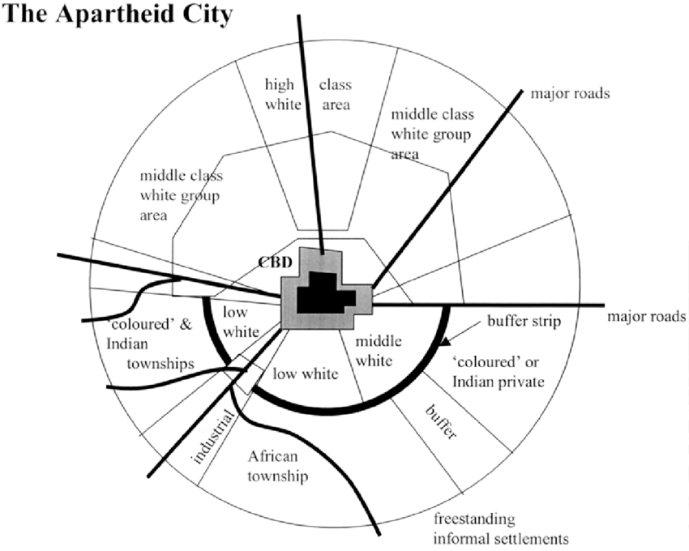
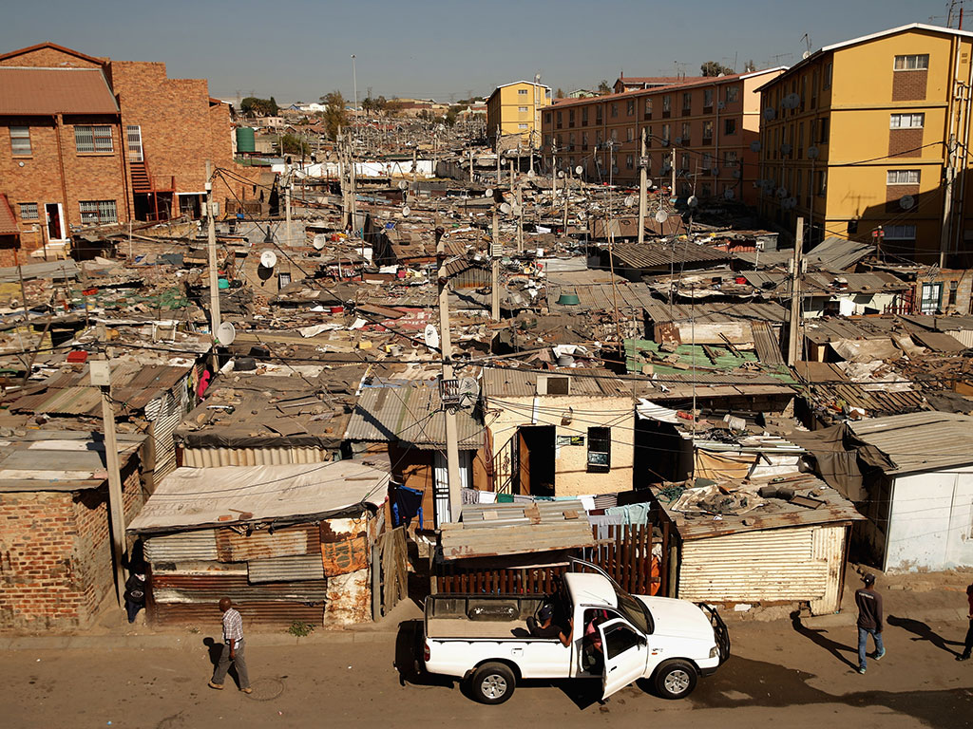
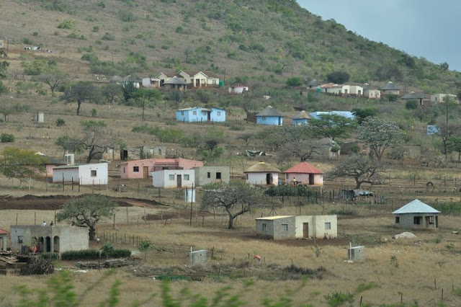
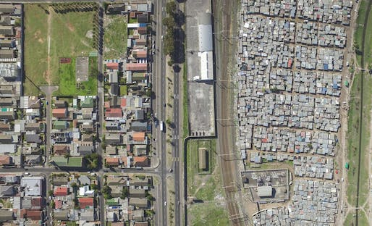
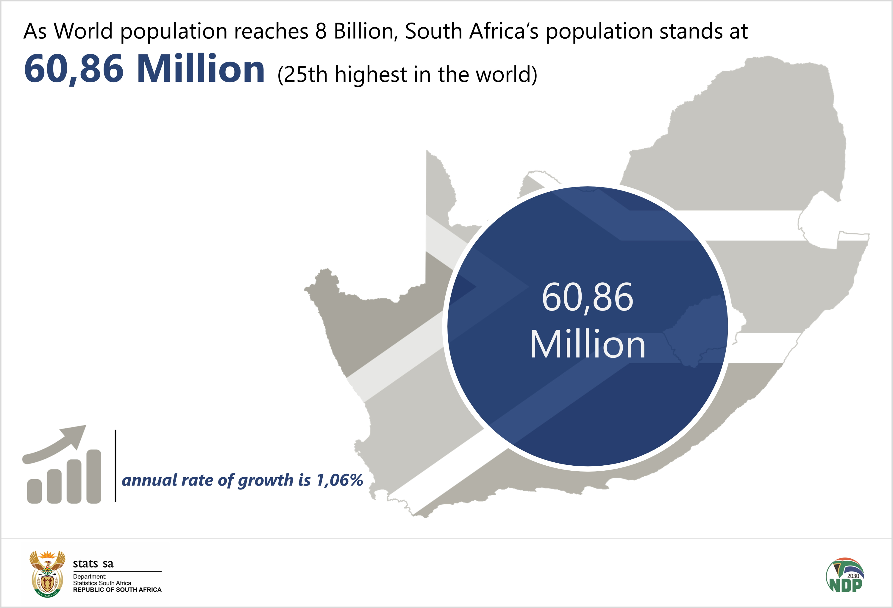
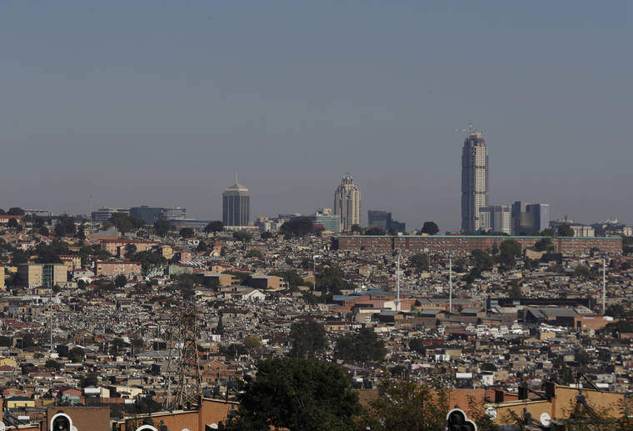
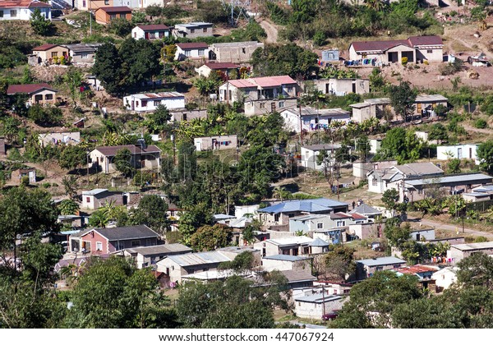
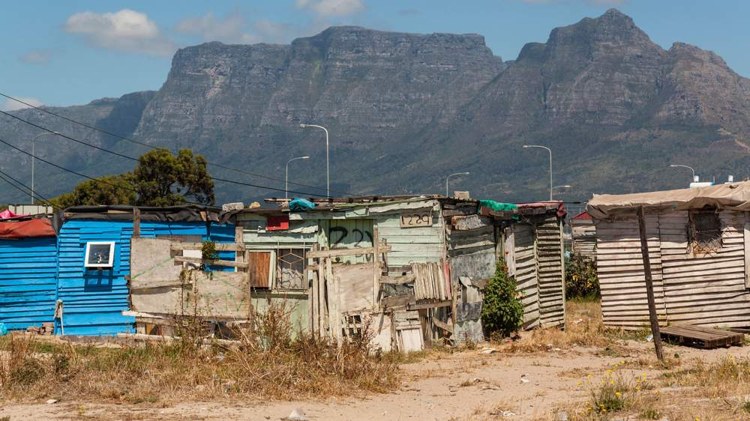
  Known knowns
Former Pres Thabo Mbeki once said:
Historical Injustice – 1978 : South Africa is a special case
A tale of two nations -1998:
“One of these nations is white, relatively prosperous, regardless of gender or geographic dispersal
The second and larger nation of South Africa is black and poor…”

Slide 11
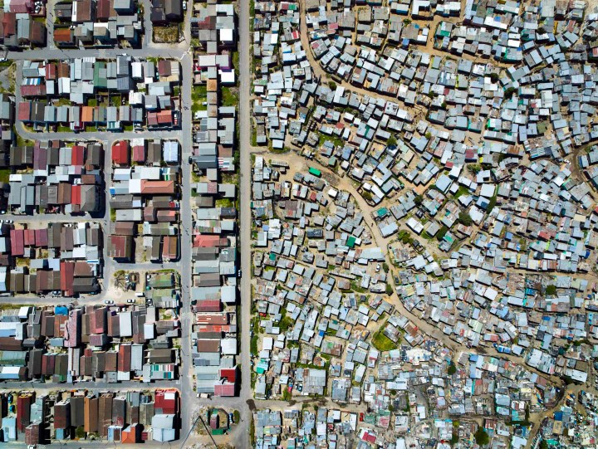
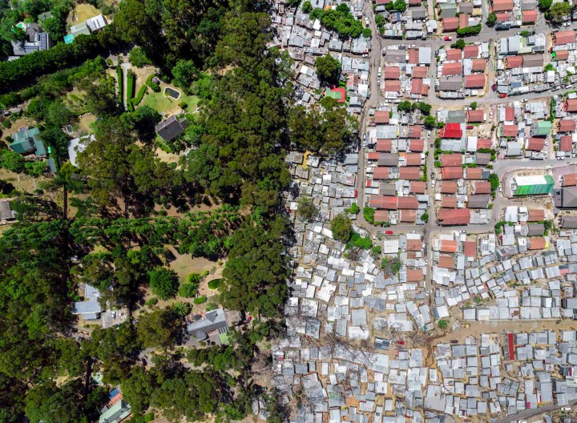
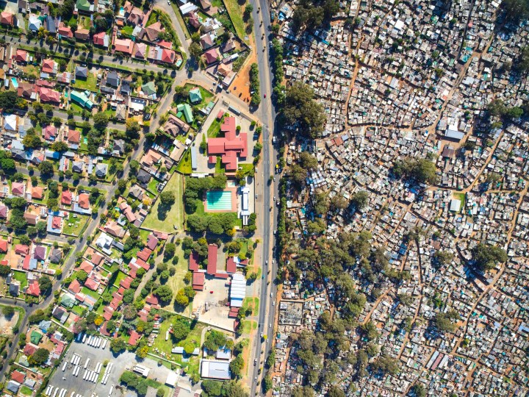
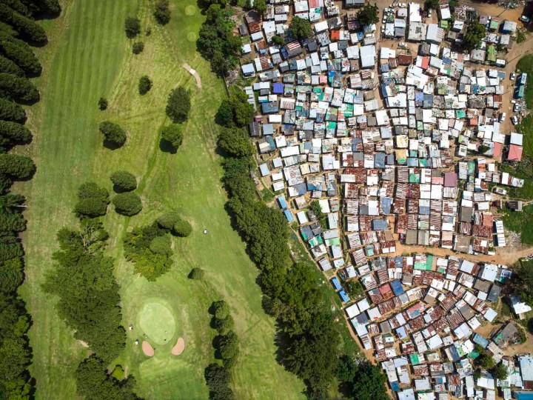
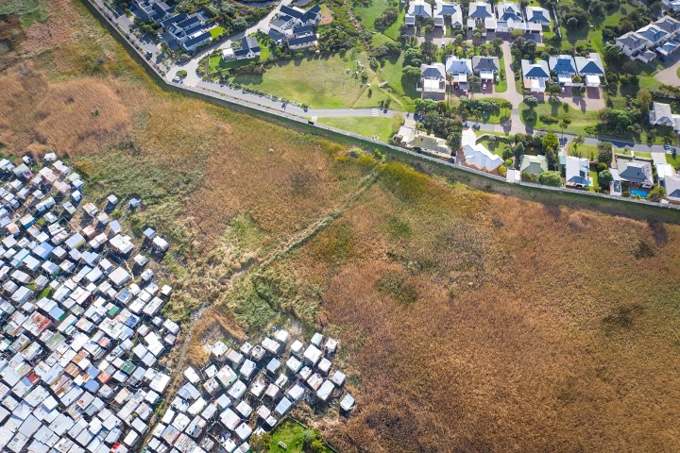
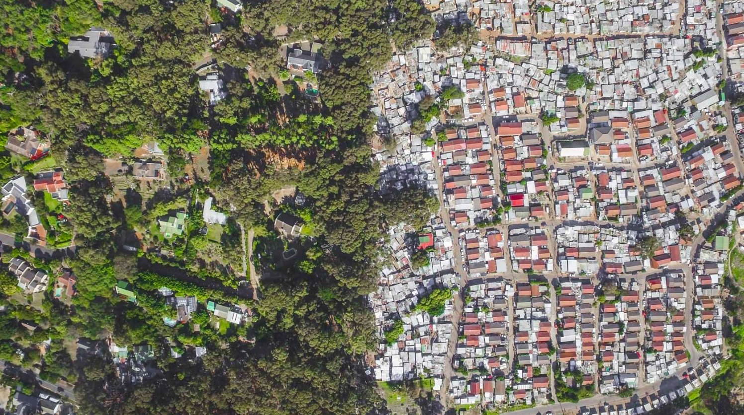
  Tale of two cities

Slide 12
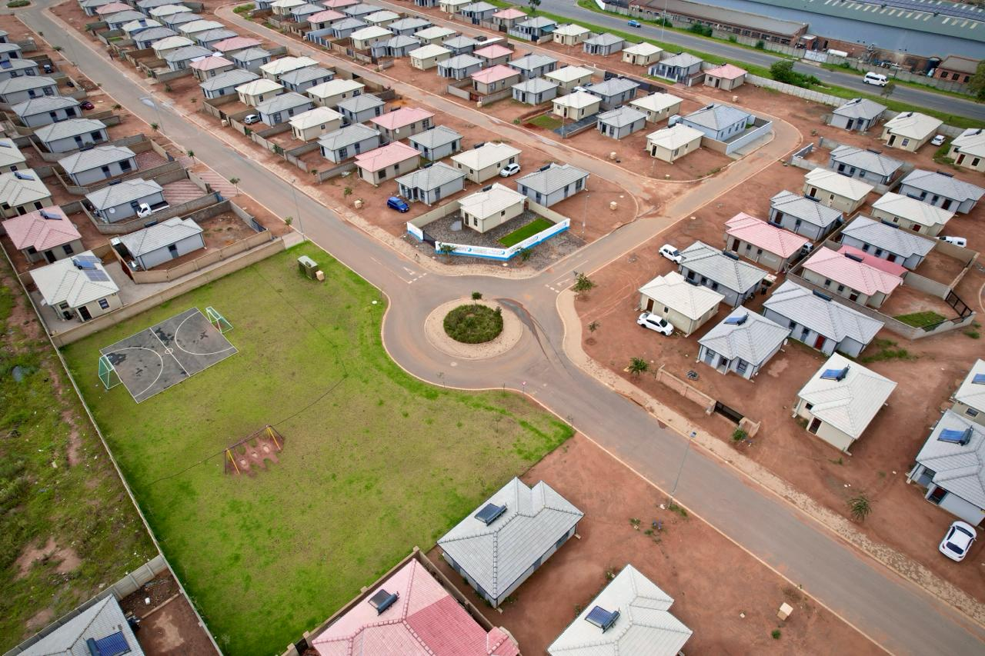
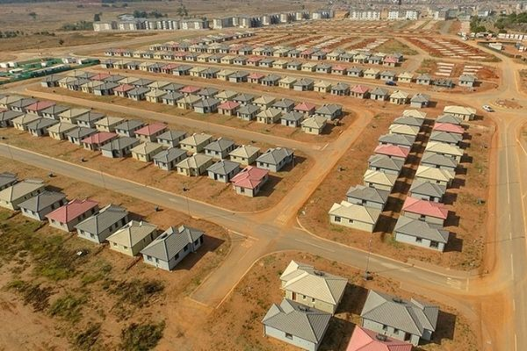
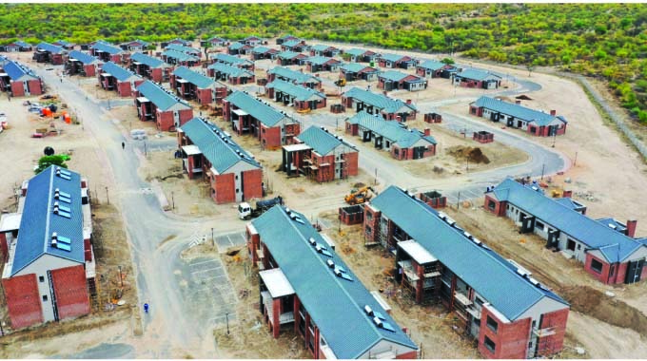
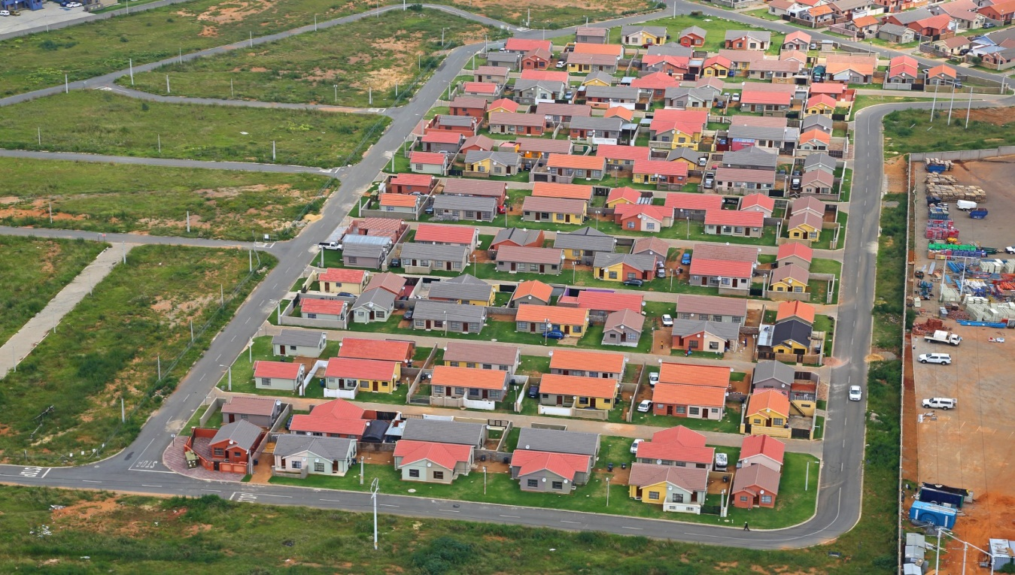
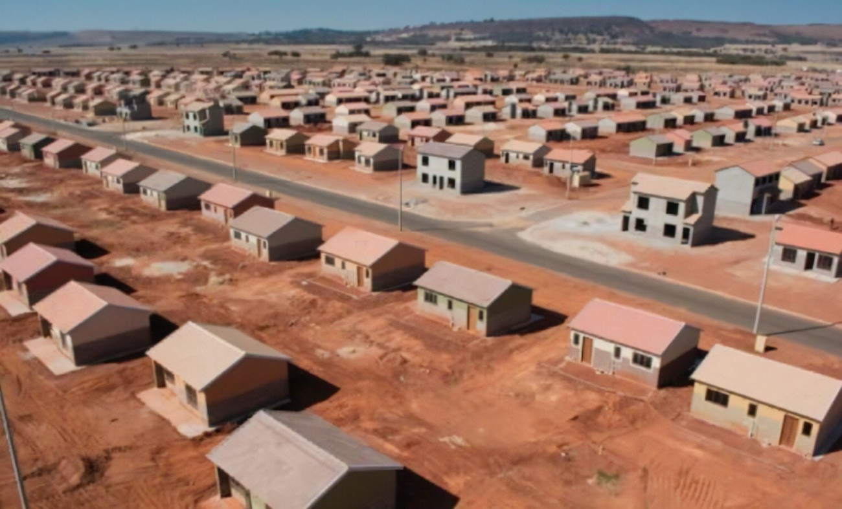
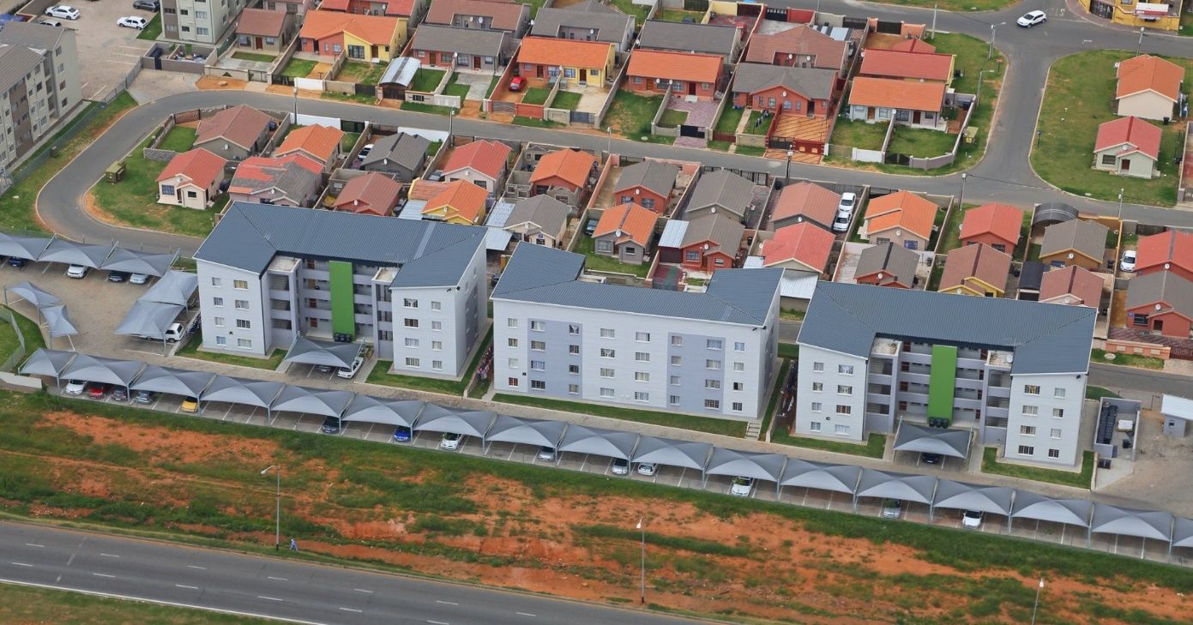
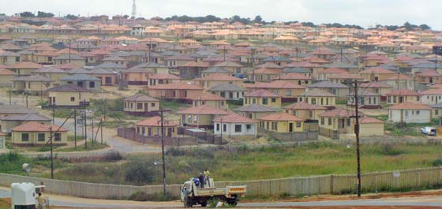
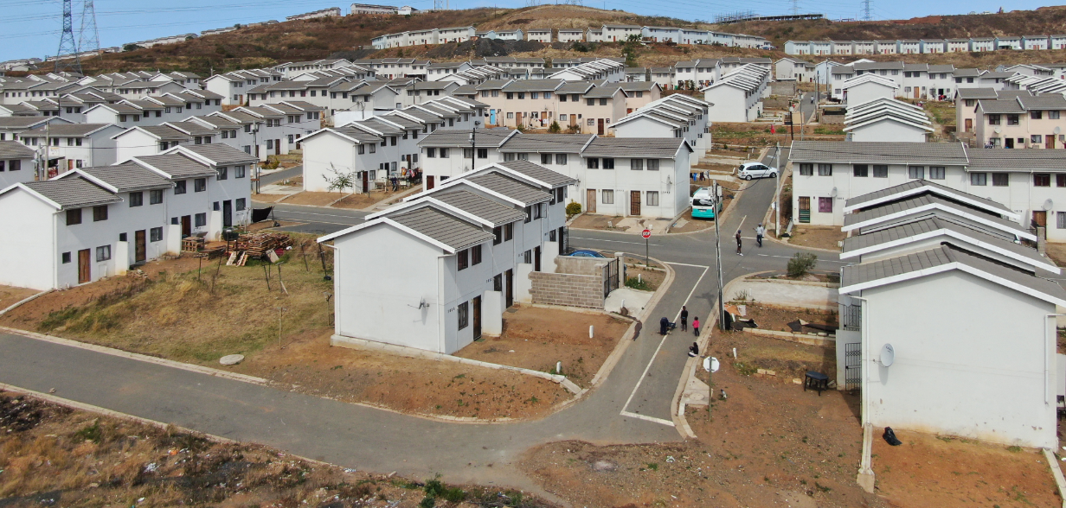
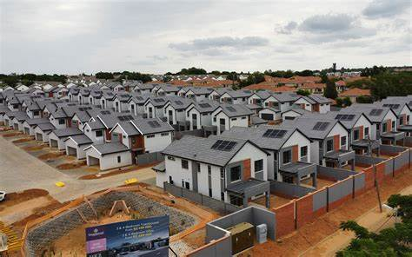
  Human Settlements: Undoing spatial injustice?

Slide 13
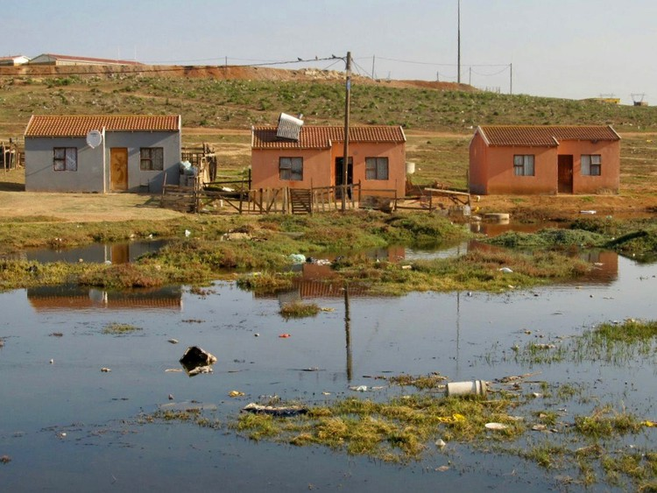
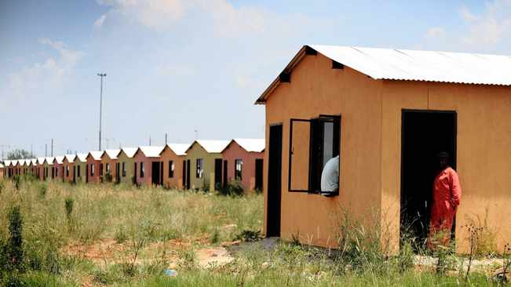
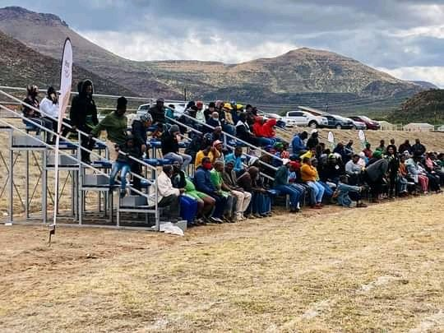
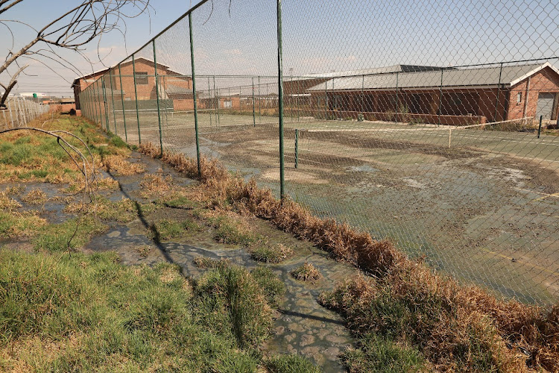
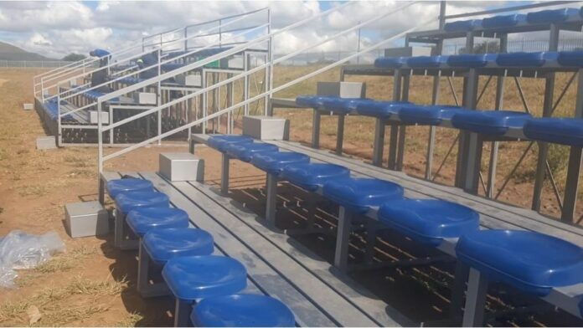
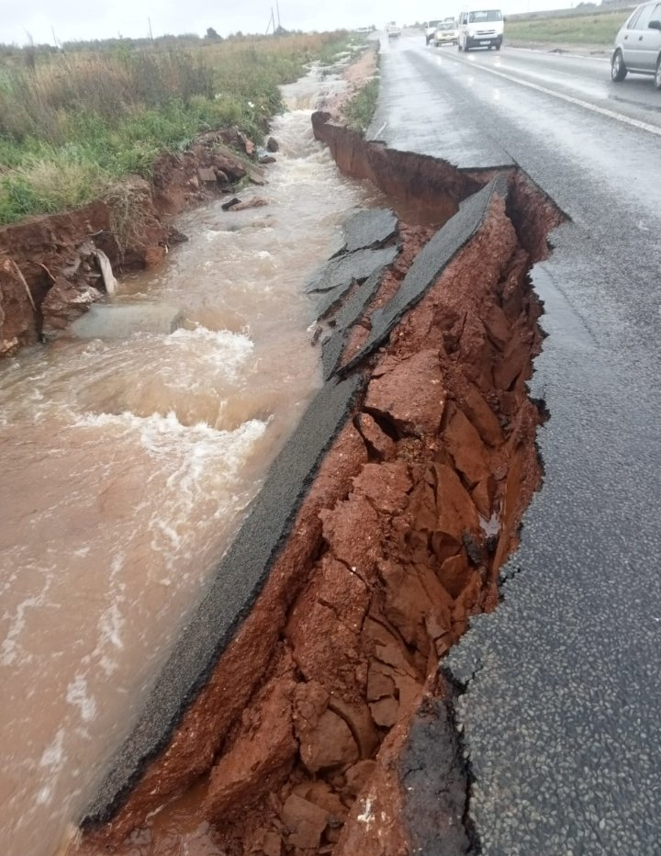
  Ethical Dilemma
Quality of professional teams has decreased with time; number of design errors and they want to correct them through variation orders.
Contractors still complain about corruption specifically in the awarding of tenders at various government departments
Government has approved social facilitation policy for all infrastructure projects

Slide 14
  Observation of changes over time in the built environment
Distribution of built environment powers and functions
    Energy delivery
    Water and sanitation delivery
    Public transport
    Transport
    Health
    Ambulances, disaster management, fire and emergency services
    Community facilities
    Education
    Telecommunication
  Built environment professionals requires collaboration, social infrastructure and mediation
Challenges in service delivery in rural areas: the case of traditional areas
Role of the courts in shaping the built environment
Climate change
Technological advances
Construction sector (“construction mafia”)
Corruption and ethical dilemma

Slide 15

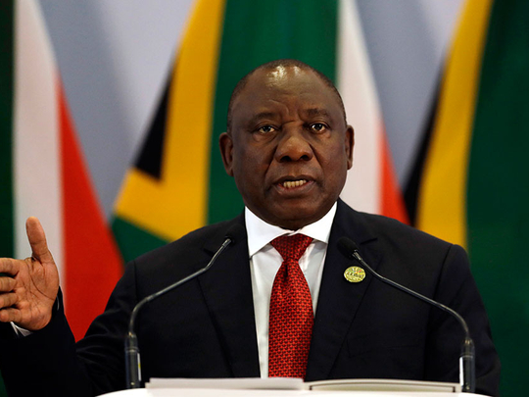
  Professionalisation of the Built Environment
“ The third strategic priority of the Government of National Unity is to build a capable, ethical and developmental state.
We will proceed with the work already underway to professionalise the public service, ensuring that we attract into the state people with skills, capabilities and integrity..”
- President Cyril Ramaphosa, 18 July 2024

Slide 16
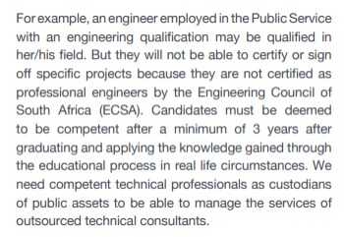
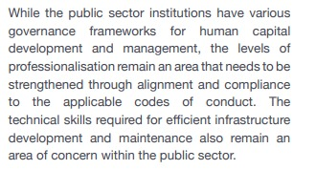
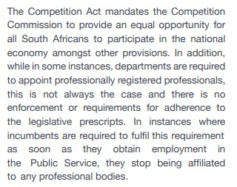
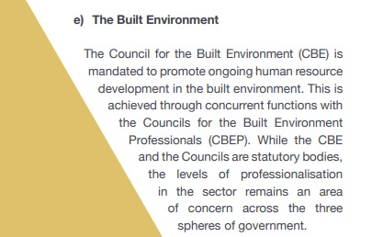
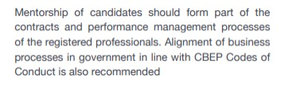
  National Framework towards the professionalization of the public sector

Slide 17










we must tackle the task in three parts :
  Framework for Professionalisation of the Public Sector
D
I
S
C
I
P
L
I
N
E
TO BE PROFESSIONAL
means to work and project yourself in a way that demonstrates superior levels of acquired knowledge, SKILLS, COMPETENCE AS WELL AS EXEMPLARY CONDUCT, COMMITMENT TO THE PROFESSION & ITS CODE OF CONDUCT
IS INSTRUCTUVE
I
N
D
I
V
I
D
U
A
L
PROFESSIONALISM
entails a high work ethic and adherence to STANDARDS AND PRINCIPLES OF SPECIFIC WORK DISCIPLINE AND CONTEXT; INCLUDING QUALIFICATIONS, SKILLS, COMPETENCIES AND VALUES.
PROFESSIONALISATION
S
E
C
T
O
R
subject ALL EMPLOYEES TO A SINGLE DISPENSATION of professional registration and regulation. RECOGNITION OF THE VARIOUS PROFESSIONAL CATEGORIES within the sector, and subject them to REGISTRATION WITH EXTERNAL REGULATED EXTERNAL PROFESSIONAL BODIES.
LEARN SERVE GROW

Slide 18
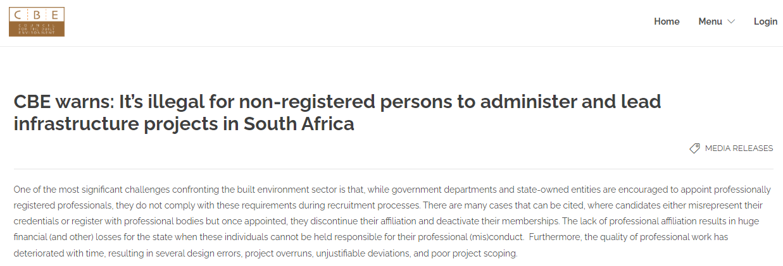

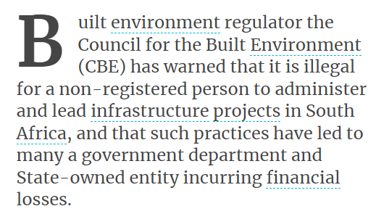

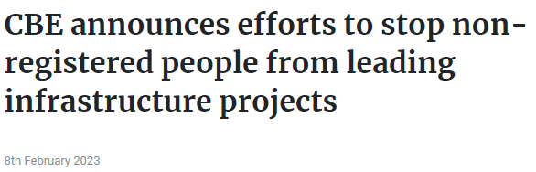
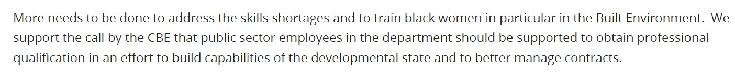
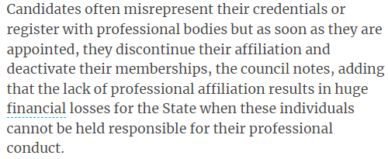
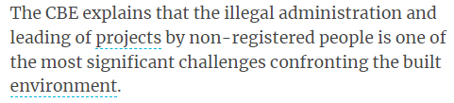

Slide 19
  When we ask graduates even those working for public sector on why they are not registered with Regulatory Councils ?
It’s a free for all there in the built environment
Gate keeping in professional bodies
Lack of transformation
Lack of standardisation of Candidacy programmes
Corruption
No incentives for being professionally registered
Anyone can masquerade built environment specialist
Protect us so we can protect the public
Lack of structured mentorship
Outsourcing / Tenderisation of the state
Professional bodies are administered people who not possess built environment sector specialists
Lack of consequence management
Lack of recognition
Nepotism /reporting to non-registered professional
No reservation of built environment work
Lack of career prospects
None adherence to rules and regulations by professional by public sector
Kusizangani?
Structural Barriers to enter built environment

Slide 20
  Built Environment Professionalisation and Skills Development Strategy for the Public Sector
      The “Built Environment Professionalisation and Skills Development Strategy for the Public Sector”, was endorsed by MinMEC of Public Works and Infrastructure of 30 November 2023.
      The strategy interventions respond to the 2023 State of the Nation Speech by President Cyril Ramaphosa that stated that “One of the greatest obstacles to infrastructure investment is the lack of technical skills, contract and project management capacity to drive infrastructure investment project management capacity.”
      In summary the strategy is aimed at :
        the transforming the built environment in South Africa through fit-for-purpose professionals that are futuristic ,inclusive in their approach, innovative, a
        embraces the realities of climate change in infrastructure build and human settlement programme
        embraces indigenous knowledge in the delivery of infrastructure and development of sustainable cities, towns, and villages.
      For the purposes of this conversation, the strategy is looking at building a strong profession based on partnerships and collaborations, that adds value, and emphasizes inclusivity and diversity, particularly encompassing the previously disadvantaged, women, youth and persons with disabilities

Slide 21
  Built Environment Professionalisation and Skills Development Strategy for the Public Sector
The process flow of the proposed transformation policy framework
Enablers
Outcome
Leadership commitment
Capability development
Engagement of operational team
Real time data analysis and design
Framework
Effective transformation
Sustained efficiency
Inculcate ownership
Low cost implementation
Tangible results
Built Environment Professionalisation and Skills Development Strategy for the Public Sector
Execute
Define
Design
Diagnose
People
Technology
Citizens
Data
Process
Government

Slide 22
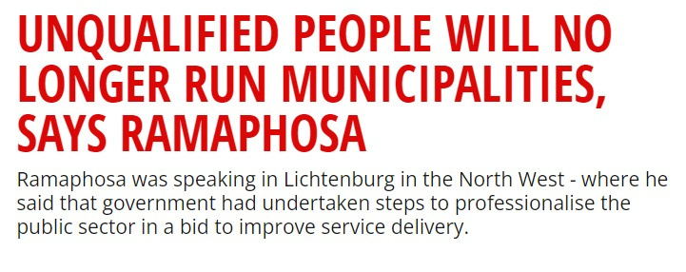
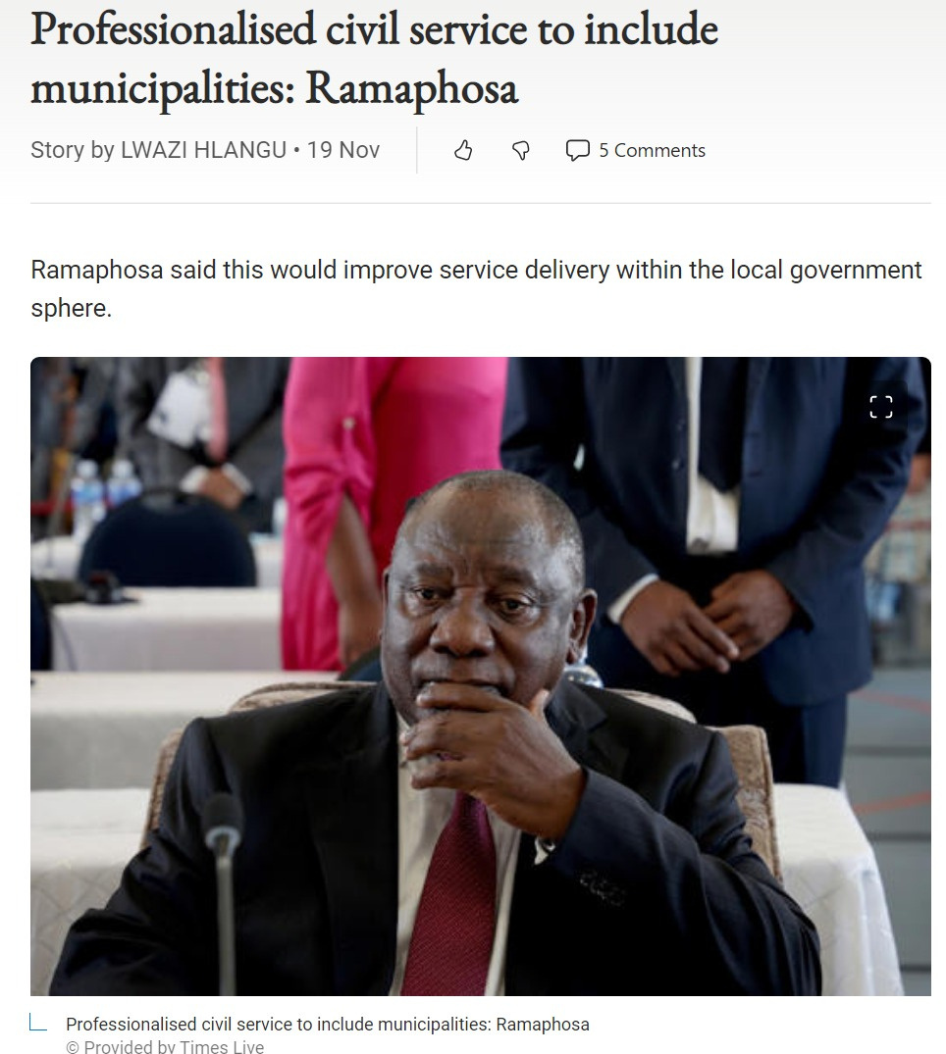
  Developing tailor-made compulsory programmes
Make it illegal for a non-registered person to administer infrastructure projects
Legislate that Built environment work must be performed by professionally registered persons
CBE , Professional Councils and NSG are in a process of developing tailor-made compulsory programmes for non-registered built environment persons in the public sector
An 18-month to two-year programme composed of formal lectures, workshops and workplace experience. Typically, a series of two- or three-day modules would cover guidelines on various aspects of the public sector.
Enforce the implementation of code of conduct for the built environment
Applicable to 3 spheres of government including the private sector

Slide 23




  Envisioning the future : Transformational
Training
Mentorship
CBE should play a central role in endorsing training initiatives tailored for built environment professionals. Such training should aid in incorporating development and transformation objectives within infrastructure delivery, particularly when it comes to understanding procurement processes and their integration with transformation goals
Need to improve the visibility of mentorship initiatives in order to increase in-service training enthusiasm among young graduates
Support for registered professionals
Data-driven advisory
CBE should consistently assess the professional registration demographics in South Africa, focusing on identifying and addressing any obstructions to the registration process
During economic downturns or industry recessions, there is a heightened need for continuous development support for already registered professionals, ensuring they remain updated and equipped in their fields

Slide 24

  Envisioning the future : Educational Role
CURRICULUM DEVELOPMENT AND INTERDISCIPLINARY STUDIES
Many institutions, expressed a desire for the CBE to provide guidance on aspects naming qualifications, setting learning outcomes, and student placement; creating a unified standard for educational institutions to follow, ensuring a coherent approach across the sector
Emphasis on interdisciplinary studies reflects the changing nature of built environment education
FACILITATING COLLABORATION AND TECHNOLOGY
Need for the CBE to bridge the gap between academia, the private sector, government, and communities
Integration of technology, digital tools, and software in education is essential to prepare students for modern practices
PUBLIC AWARENESS OF BUILT ENVIRONMENT PROFESSIONS
CBE can play a proactive role in promoting the significance of these professions, highlighting employment opportunities and combating negative perceptions
INCENTIVES
Institutions stressed the importance of financial support, especially for underprivileged students
FACILITATING EMPLOYMENT, MENTORING AND INTERNSHIPS
The importance of aiding students in their transition from academia to the workplace

Slide 25

  A call for alternative voices in the built environment
I argue that it is time we humanise the built environment through the provision of fit-for-purpose professionals that understand South Africa’s Development Agenda

Slide 26
Technically equipped professionals with knowledge to assist in resolving societal challenges and drive development
Competent and compatibility – understanding that working for government is a service
Fit for purpose-built environment professionals ("municipal engineer, project managers, or town planner who will understand basics about the environment they will be exposed to (MFMA, PMFMA, governance structures)
  What type of built environment capacity do we need to drive infrastructure development?

Slide 27
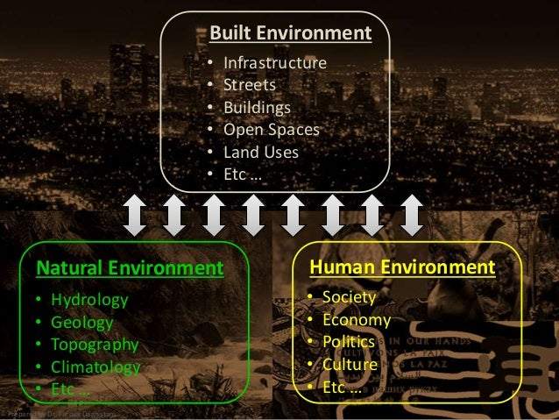
  Built Environment Education
  Need to rethink and review the built environment academic programmes – “fit-for-purpose”
  Not just few modules but trained Built Environment Professionals to have an appreciation of the climate change issues and its impact on society especially the vulnerable groups
  The decolonization of the built environment curriculum
  Connect people, information, and resources, and work with other organizations and private citizens to solve complex problems.
  Put people at the centre of the built environment profession
  Give effect of the Constitutional values by re-imagine places and spaces of the future

Slide 28
  Conclusion
The spirit of collaboration and partnership has been instrumental in driving progress in the built environment, with stakeholders from across the spectrum coming together to address common challenges and work towards shared goals
As CBE, wer am confident that with the same spirit of resilience, determination, and unity that has brought us this far, we will continue to make great strides towards a brighter and more sustainable future for all
Importantly, let us recommit ourselves to transform the built environment sector, to transform South Africa’s places and spaces, villages, towns, and cities

Slide 29
  Take aways from my input
The future looks bright for the built environment sector, but it must :
  Transform, be inclusive and professionalise -Prioritise women, youth and persons with disabilities
  develop professionals that are technically competent, ethical that embrace Ubuntu and indigenous knowledge
  Accept that climate change has imposed an added responsibility on how we plan, develop and maintain infrastructure (resilient)
  Be agile, adapt to technologic advances to drive innovation (design, procurement, delivery, and maintenance)
  Skills and training across the built environment sector: de-skilling, reskilling, and upskilling
  Delivering a built environment that provides quality infrastructure and buildings (ON TIME AND WITHIN BUDGET)
The future of Built Environment : The built environment of the future must be embedded on inclusivity, sustainability and responsive to societal needs
4

